Slide 1
American Association of Endocrine Surgeons Guidelines for Adrenalectomy
Highlights from the 2024 AAES Guidelines and Emerging Therapeutics Committee
*These slides are property of AAES. Medical management of individual patients varies considerably and may vary from the material within the materials that follow. The AAES is not responsible for patient care decisions made by those providing clinical care.

Slide 2
AAES Guidelines and Emerging Therapeutics Committee – Adrenal Guidelines Workgroup 2024
Dawn Elfenbein- Project Chair
Jordan Broekhuis
James Davis
Insoo Suh
Tanaz Vaghaiwalla
James Wu
Nicole Zern
Scott Wilhelm- Committee Chair
The above authors were responsible for creation of the slides that follow.

Slide 3
AAES Adrenalectomy Guidelines
American Association of Endocrine Surgeons Guidelines for Adrenalectomy: Executive Summary
Summary of essentials in bullet point format
39 references
JAMA Surg.2022;157(10):870-877
https://jamanetwork.com/journals/jamasurgery/fullarticle/2795363
Full document may be accessed as an ‘Online Supplement’
112 pages of recommendations, supporting evidence, tables, figures, and pearls
401 references

Slide 4
Authors of the AAES Guidelines for Adrenalectomy
Linwah Yip, MD;
QuanYang Duh, MD;
Heather Wachtel, MD;
Camilo Jimenez, MD;
Cord Sturgeon, MD;
Cortney Lee, MD;
David Velázquez-Fernández, MD, MSc, PhD;
Eren Berber, MD;
Gary D. Hammer, MD,PhD;
Irina Bancos, MD;
James A. Lee, MD;
Jamie Marko, MD;
Lilah F. Morris-Wiseman, MD;
Marybeth S. Hughes, MD;
Masha J. Livhits, MD;
Mi-Ah Han, MD;
Philip W. Smith, MD;
Scott Wilhelm, MD;
Sylvia L. Asa, MD, PhD;
Thomas J. Fahey III, MD;
Travis J. McKenzie, MD;
Vivian E. Strong, MD;
Nancy D. Perrier, MD

Slide 5
Guideline Author Disclosures
Members of the AAES guidelines for adrenalectomy disclosures
Conflict of Interest Disclosures: Dr Wachtel reported grants from the National Institutes of Health (NIH), National Center for Advancing Translational Sciences (KL2 TR001879) during the activity period. Dr Jimenez reported research support from Lantheus Pharmaceuticals, Progenics, Exelixis, MSD, and Pfizer and serving on an advisory board for HRA Pharma and Pfizer during the activity period. Dr Berber reported consulting for Medtronic, Aesculap, and Ethicon outside the submitted work. Dr Hammer reported being a founder of and consultant for Vasaragen, having patents for diagnostics via Vasaragen and the University of Michigan, and being the editor or associate editor of two textbooks outside the submitted work. Dr Bancos reported grants from the NIH and fees to her institution from HRA Pharma, Corcept, Lantheus, Recordati, Spruce, Sparrow, and Adrenas outside the submitted work. Dr Asa reported serving as an advisor for Leica Biosystems, Ibex Medical Analytics, and Iron Mountain outside the submitted work. Dr Fahey reported being a consultant and investor in Mediflix Inc. No other disclosures were reported

Slide 6
Select Previously Published Guidelines
Stefanidis D, Goldfarb M, Kercher KW, Hope WW, Richardson W, Fanelli RD; Society of Gastrointestinal and Endoscopic Surgeons. SAGES guidelines for minimally invasive treatment of adrenal pathology. Surg Endosc. 2013 Nov;27(11):3960-80. doi: 10.1007/s00464-013-3169-z. Epub 2013 Sep 10. PMID: 24018761.
Zeiger MA, Thompson GB, Duh QY, Hamrahian AH, Angelos P, Elaraj D, Fishman E, Kharlip J; American Association of Clinical Endocrinologists; American Association of Endocrine Surgeons. American Association of Clinical Endocrinologists and American Association of Endocrine Surgeons Medical Guidelines for the Management of Adrenal Incidentalomas: executive summary of recommendations. Endocr Pract. 2009 Jul-Aug;15(5):450-3. doi: 10.4158/EP.15.5.450. PMID: 19632968.
Fassnacht M, Arlt W, Bancos I, Dralle H, Newell-Price J, Sahdev A, Tabarin A, Terzolo M, Tsagarakis S, Dekkers OM. Management of adrenal incidentalomas: European Society of Endocrinology Clinical Practice Guideline in collaboration with the European Network for the Study of Adrenal Tumors. Eur J Endocrinol. 2016 Aug;175(2):G1-G34. doi: 10.1530/EJE-16-0467. PMID: 27390021.

Slide 7
Why Create a New Set of Guidelines?
Surgical treatment of adrenal disease has undergone extensive change over the past 2 decades (improved imaging, minimally invasive techniques, etc.)
Efforts to standardize the approach to diagnosis, treatment, and surveillance are valuable
Increased use of minimally invasive, robotic, and retroperitoneal approaches to adrenalectomy has resulted in new data comparing various approaches

Slide 8
Goals of the AAES Guidelines
Provide caregivers with a background understanding of the epidemiology and pathogenesis of adrenal tumors
Outline the approach for imaging and functional evaluation of adrenal tumors
Detail the pre- and intra-operative management of various adrenal tumors based on functional status and concern for malignancy
Delineate methods for safe and effective postoperative management and any needed adjuvant therapy
Summarize the existing data and highlight areas of uncertainty regarding optimal operative approach

Slide 9
Grading of Recommendations, Assessment, Development and Evaluation (GRADE) methodology
GRADE certainty ratings
Very low – The true effect is probably markedly different from the estimate effect
Low – The true effect might be markedly different from the estimated effect
Moderate – The authors believe that the true effect is probably close to the estimated effect
High – The authors have a lot of confidence that the true effect is similar to the estimated effect

Slide 10
American College of Physicians Grading
Grading designation
Strong- Benefits outweigh risks/Should be applied to all pts.
Weak- Benefits balance the risks
Insufficient- not enough evidence to judge.
Strength of Recommendation
High- RCT or overwhelming evidence
Moderate- RCT with limitations, designed cohort studies, Large observational studies
Low- potentially biased or small observational or case studies.

Slide 11
Incidentalomas, Myelolipomas, and Cysts

Slide 12
Adrenal Incidentaloma
Imaging features are key to evaluation of incidental adrenal lesions
Adrenal Protocol CT =
1) Non-contrast phase
If Hounsfield Units ≥ 10, proceed with:
2) Venous phase (60-75 seconds after contrast)
3) Delayed phase (15 minutes)
Incidental nodules with non-contrast HU < 10 = Benign
Recommendation 1.1. We suggest that washout characteristics on an adrenal protocol CT be used to stratify the risk of malignancy for adrenal nodules when non-contrast HUs are greater than 10 and other clinical risk factors for malignancy are not present.

Slide 13
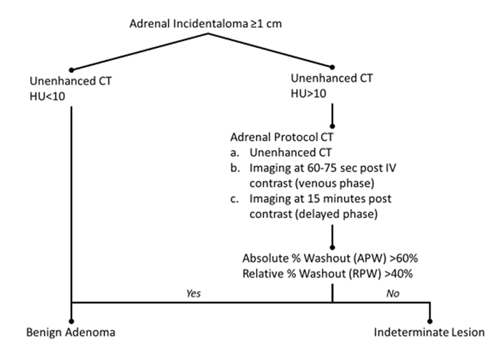

Slide 14
Recommendation 1.2
All patients with an adrenal incidentaloma 1 cm or larger should undergo biochemical testing for autonomous cortisol secretion.
Patients with hypertension or hypokalemia also require biochemical evaluation for primary aldosteronism.
Patients with adrenal imaging findings that have non-contrast CT with HU>10 should undergo evaluation for pheochromocytoma.

Slide 15
Recommendation 1.3
Consider primary adrenal malignancy if:
Adrenal lesion >4 cm
Non-contrast HU >20
Patient <18 yo
*Comprehensive biochemical evaluation is indicated in all patients with indeterminate masses when cancer arising from the adrenal gland is in the differential
Consider metastasis if personal history of other malignancy, signs, symptoms, or family history are suggestive.

Slide 16
Recommendation 1.4: Surveillance of Incidentalomas
Biochemically non-functional tumor, non-contrast HU<10, and/or size <4 cm
No imaging follow-up
Nonfunctional
Repeat cortisol assessment in 2-5 years or if patient develops other signs/symptoms suggestive of other hormone excess
Size 1-4 cm, indeterminate imaging features, history of malignancy
Repeat imaging in 6-12 months to assess for interval growth/change
Indeterminate imaging features on CT = HU ≥10, absolute washout <60%, relative washout <40%
Consider MRI and/or PET CT as alternative imaging modalities

Slide 17
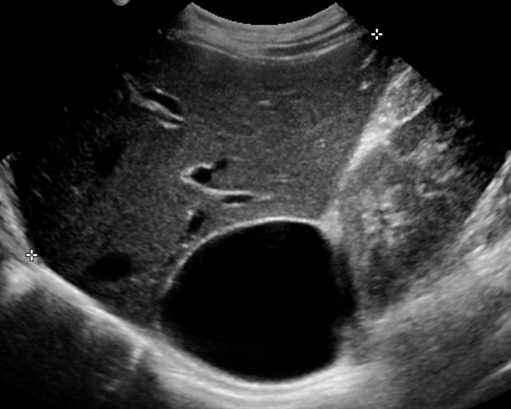
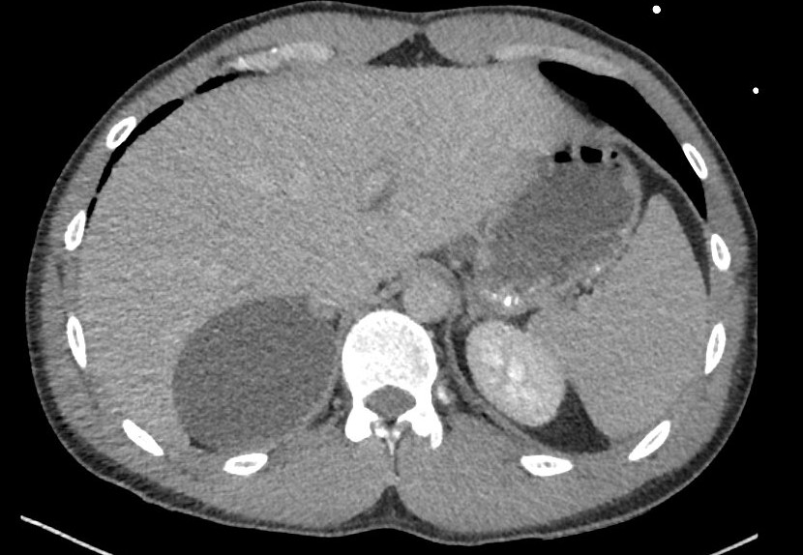
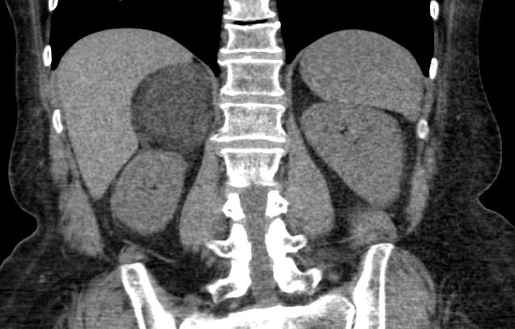
Recommendation 1.5: Myelolipoma & Cysts
Avoid resection of myelolipomas or adrenal cysts that have pathognomonic imaging features unless there are symptoms of mass effect
Cyst- no contrast enhancement
Myelolipoma- macroscopic fat, very low HU (<0)
Consider resection if indeterminate imaging features, prior hemorrhage, mass effect or substantial growth on interval imaging

Slide 18
Primary Aldosteronism

Slide 19
In patients with primary aldosteronism (PA), does adrenalectomy compared with mineralocorticoid antagonist therapy alone improve related comorbidities and mortality?
Recommendation 2.1. We recommend laparoscopic adrenalectomy for unilateral PA as patients are more likely to:
Use fewer medications with lower defined daily dosages to achieve normalization of blood pressure and potassium levels
Have lower risks of new-onset atrial fibrillation, CKD, stroke, and all-cause mortality
Strong recommendation, low-quality

Slide 20
In patients with PA and cross-sectional imaging consistent with a unilateral adenoma, does preoperative adrenal venous sampling increase the likelihood of a clinical or biochemical cure?
Recommendation 2.2. We suggest that AVS can be deferred in patients 35 years and younger with cross-sectional imaging demonstrating unilateral adenoma and normal contralateral gland
Cure rates are similar in this younger population to adrenalectomy guided by AVS
AVS recommended for patients 35 years and older
Weak recommendation, low quality evidence

Slide 21
In patients with PA due to unilateral disease, does laparoscopic adrenalectomy improve health-related quality of life and/or reduce health care-related costs compared with medical management?
Recommendation 2.3. We recommend laparoscopic adrenalectomy for primary aldosteronism due to unilateral disease
Improved quality of life
Reduced health care-related costs
Strong recommendation, low quality evidence

Slide 22
Hypercortisolism

Slide 23
Mild Autonomous Cortisol Secretion
Mild autonomous cortisol secretion (MACS), previously known as subclinical Cushing syndrome
Patients with MACS lack classical stigmata of overt CS, but have high prevalence of obesity, arterial HTN, T2DM, vertebral fractures, and CV morbidity/mortality
0.2-2% of the general adult population, 5-30% of patients with adrenal incidentaloma

Slide 24
MACS
Testing
Overnight 1 mg dexamethasone suppression test (DST) is preferred
Cortisol ≥1.8 mg/dL with concomitant dexamethasone level >100-180 ng/dL is supportive
Other biochemical testing should be pursued according to Endocrine Society guidelines
ACTH often low-normal, but can be >20 pg/mL
Other screening tests for hypercortisolism (e.g. 24-hr urine cortisol, midnight salivary cortisol) frequently normal in MACS
Recommendation 3.1. Patients with MACS secondary to a unilateral adenoma should undergo laparoscopic adrenalectomy because of anticipated significant improvements in cardiometabolic complications.
Strong recommendation, moderate quality evidence

Slide 25
Bilateral ACTH-Independent Cushing Syndrome
Subdivided into macronodular versus micronodular
Macronodular: Primary bilateral macronodular adrenal hyperplasia (PBMAH)
Previously called ACTH-independent macronodular adrenal hyperplasia (AIMAH)
Micronodular:
Primary pigmented nodular adrenocortical disease (PPNAD)
More commonly familial – Carney complex makes up 60% of cases
Isolated micronodular adrenocortical disease
Bilateral adrenalectomy is one treatment option for bilateral ACTH-independent CS, but resultant lifelong steroid dependence and risk of adrenal crisis are significant downsides

Slide 26
Bilateral Macronodular Hyperplasia
Growing interest in whether unilateral adrenalectomy of the larger gland may be beneficial in selected ACTH-independent CS patients with PBMAH
Can safely achieve biochemical resolution of hypercortisolism in 84-100% of selected patients
Improvement in metabolic parameters: BMI, BP, T2DM
High recurrence rates – 13-68% at 4 years
Recommendation 3.2. In patients with ACTH-independent CS due to bilateral macronodular hyperplasia, unilateral laparoscopic adrenalectomy should be considered in an attempt to achieve biochemical remission of hypercortisolism without causing adrenal insufficiency.
Weak recommendation, low-quality evidence

Slide 27
ACTH-Dependent Hypercortisolism
ACTH-dependent Cushing Syndrome (CS) is due to either pituitary Cushing disease or ectopic ACTH production
Most cases managed with medical and surgical treatment of the primary source, but a subset have persistent CS refractory to primary treatment
Medical therapies: cabergoline, pasireotide (for pituitary Cushing disease); steroidogenesis inhibitors (metyrapone, ketoconazole), mifepristone, and others
Patients with CS who do not undergo treatment have 4.6x higher mortality rate compared to the general population

Slide 28
ACTH-Dependent Hypercortisolism
Minimally invasive techniques allow for bilateral adrenalectomy for patients with medically-refractory ACTH-dependent CS with excellent technical outcomes and acceptable overall risks
Results in symptomatic improvement in ~90% of pituitary Cushing disease patients
Risk of perioperative morbidity 10%, mortality 3%
Risk of adrenal crisis: 0.93 per 10 patient-years
Nelson’s syndrome occurs in 21% of patients, but <9% of patients require pituitary surgery
Recommendation 3.3. Patients with moderate to severe ACTH-dependent hypercortisolism refractory to source control should undergo bilateral laparoscopic adrenalectomy to ameliorate cortisol excess and improve disease-free survival and mortality.
Weak recommendation, low-quality evidence

Slide 29
Postoperative Adrenal Insufficiency
Postoperative adrenal insufficiency (AI) is a life-threatening condition and should be prevented or promptly managed
Symptoms: fatigue, hypotension, anorexia, abdominal pain, weakness, syncope, back pain, nausea, vomiting , fever, confusion
Incidence in AI after unilateral adrenalectomy:
100% in patients with overt CS
60% in patients with MACS
Duration of postoperative glucocorticoid replacement therapy, if needed, is dependent on degree of biochemical hypercortisolism - can last >12-18 months in some patients
Recommendation 3.4. Empirical postoperative glucocorticoid replacement therapy is recommended for all patients with overt CS after undergoing unilateral adrenalectomy. However, in patients with MACS, postoperative day 1 morning cortisol or corticotropin stimulation testing could be used to determine the need for glucocorticoid replacement therapy.
Strong recommendation, low-quality evidence

Slide 30
Adrenocortical Carcinoma

Slide 31
Adrenalectomy: Volume – Outcomes Relationship
High volume adrenal surgeons:
Perform 4-7 or more adrenal operations per year
This data is not specific to ACC and includes mostly benign cases
Have lower complication rates vs low volume surgeons (11% vs 18%)
Overall survival after adrenalectomy when comparing high vs. low volume centers is similar for adrenalectomy in general
Recommendation 4.1. We recommend that patients with clinical and radiographic findings consistent with ACC should be treated at high-volume multidisciplinary centers to improve recurrence outcomes; data on overall survival are inconclusive

Slide 32
In patients with ACC without evidence of distant metastatic disease at diagnosis, does operative technique affect survival?
Open adrenalectomy is associated with higher rates of negative margins compared to laparoscopic adrenalectomy, which may increase risk of violation of tumor capsule, tumor spillage, and local recurrence.
However, survival was not different between laparoscopic vs open surgery in a subset with negative margins in some, but not all studies
Data regarding laparoscopic vs. open adrenalectomy has many limitations and should be interpreted with caution
Recommendation 4.2. Regardless of operative approach, we recommend an en-bloc radical resection with an intact capsule to microscopically negative margins. Open resection is preferred.
Strong recommendation, low-quality evidence.

Slide 33
In patients with ACC and systemic disease at diagnosis, does resection of the primary tumor improve survival?
Stage 4 ACC has a 5-year survival of 6-13%
In some studies, surgery demonstrates a survival advantage over no surgery, even in stage 4 ACC
5-yr survival after palliative resection remains 4.5%
Data regarding resection in the setting of Stage 4 ACC has many limitations, is greatly impacted by selection bias, should be interpreted with caution
Recommendation 4.3. We suggest that patients with systemic disease be offered resection of the primary tumor if all sites of disease are reasonably amenable to resection or local treatment and if performance status allows. Surgery may also be considered in patients with hormone excess medically refractory to steroidogenic inhibition.
Weak recommendation, low-quality evidence.

Slide 34
In patients with advanced ACC, what is the role of neoadjuvant therapy followed by resection vs surgery with or without adjuvant therapy?
In one series, 15 patients that received neoadjuvant therapy for borderline resectable disease had similar overall survival compared to 38 patients that underwent surgery first, despite higher tumor stage in the neoadjuvant group
Recommendation 4.4. We recommend that neoadjuvant systemic therapy be administered for advanced ACC when R0 surgical resection is not initially feasible. We recommend upfront surgical intervention when R0 resection is possible.
Strong recommendation, low-quality evidence.

Slide 35
Metastasis To The Adrenal Gland

Slide 36
In patients with an adrenal mass, does history of an extra-adrenal malignancy influence the hormonal evaluation?
Adrenal metastasis may have imaging features that make them indistinguishable from other pathologies, including ACC, pheochromocytoma, or lipid-poor adenomas
Functional evaluation is imperative prior to biopsy, ablation, or resection
All patients need evaluation for excess cortisol and catecholamines, those with baseline hypertension should also have aldosterone levels tested
In patients with bilateral adrenal metastases, adrenal insufficiency may be present
Recommendation 5.1. We recommend that a directed hormonal evaluation should be performed in patients with an adrenal mass regardless of history of extra-adrenal malignancy.
Strong recommendation, low-quality evidence.

Slide 37
In a patient with a history of an extra-adrenal malignancy and an adrenal mass, when is image-guided needle biopsy recommended?
If an indeterminate mass in an adrenal gland is the only site of potential metastatic disease with a known primary for a patient who is a surgical candidate, surgical resection is preferred over biopsy
If the adrenal mass is not amenable to resection, or the patient is not a good surgical candidate, biopsy may be considered to guide non-surgical therapy
The diagnostic performance for percutaneous biopsy for adrenal metastasis is 87% sensitive and 96% specific, and morbidity is low once hormonal workup has been completed to rule out pheochromocytoma (2.5%)
Recommendation 5.2. We suggest that in the setting of a radiographically indeterminate mass, image-guided biopsy be rarely performed and reserved for patients in whom results would change overall disease management and that it be performed only after confirming lack of hormone excess.
Strong recommendation, low-quality evidence.

Slide 38
In patients with an adrenal metastasis, does resection improve survival compared with systemic therapy alone?
Adrenal metastasis is most commonly due to lung, kidney, breast, melanoma, and colon malignancies.
Laparoscopic metastasectomy, when feasible, can result in similar outcomes compared to open resection.
Consideration should be given to disease pathology, disease-free interval, and tumor size to help select appropriate surgical candidates given differences between types of malignancies and a paucity of data.
Recommendation 5.3. We suggest that after multidisciplinary review, resection may be offered to highly selected patients to improve survival compared with systemic therapy alone.
Weak recommendation, low-quality evidence.

Slide 39
Pheochromocytoma and Paraganglioma

Slide 40
Pheochromocytoma and Paraganglioma (PPGL)
PPGLs are rare tumors that secrete catecholamines.
Pheochromocytomas arise from the adrenal glands
Paragangliomas arise outside the adrenal glands in multiple sites
PPGLs can cause side effects impacting multiple organ systems, including renal, cardiovascular, and other organ systems as well as metabolic derangements.

Slide 41
Pheochromocytoma and Paraganglioma
As recommended in the Endocrine Society clinic practice guideline for pheochromocytoma and paraganglioma, initial biochemical testing for PPGLs should include assessment of plasma free or urinary metanephrines and normetaneprhines.
Biochemical testing results are typically more than 2 to 3 times the upper limit of normal in functional PPGLs.
Plasma epinephrine and norepinephrine should be avoided given marked swings in levels according to activity and episodic secretion resulting in false positives and false negatives.
Plasma catecholamines may be ordered to assess dopamine.
Measurement of methoxytyramine (metabolite of dopamine) should also be considered in patients with germline pathogenic variants in succinate dehydrogenase genes (SDHx) to diagnose dopamine-secreting tumors.

Slide 42
Pheochromocytoma and Paraganglioma
Preoperative blockade for at least 7 days or longer is recommended to avoid potentially dangerous perioperative hemodynamic instability
No significant difference in morbidity or mortality between selective vs. nonselective α blockade, although there may be differences in intraoperative and postoperative hemodynamic stability
Selective blockade (ex: doxazosin, prazosin, terazosin) is associated with more intraoperative hemodynamic instability
Nonselective blockade (ex: phenoxybenzamine) results in more postoperative hypotension, postural hypotension, nasal stuffiness, higher cost, and may be difficult to acquire
Recommendation 6.1. We recommend either selective or nonselective α-blockade to safely prepare patients for surgical resection of PPGL, depending on the drug availability/cost, experience, and preference of the care team.
Strong recommendation, moderate-quality evidence

Slide 43
Preoperative Blockade
Other considerations
No census data to support calcium channel blocker use (CCB) first line; however, a CCB may be considered in certain circumstances:
Alpha blockade is not tolerated
Patient is normotensive
When additional medication is needed to achieve improved blood pressure control preoperatively not otherwise achieved with first-line options
Surgery without preoperative blockade is not recommended outside of very high-volume centers experienced specifically in treating patients with PPGL.

Slide 44
Genetic Testing
Pheochromocytomas (PCCs) and paragangliomas (PGLs) have the highest heritability of all adrenal tumors
Up to 40% due to germline mutations
Approximately 20% of patients with no family history are found to have a germline mutation
Genetic testing and counseling is recommended for all patients and 1st degree family members
Diagnosis of a germline mutation allows for evaluation of associated neoplasms, stratification for risk of cancer and recurrence, earlier diagnosis in related family members, and adjustment of treatment strategy, including surgical plan and follow-up strategy

Slide 45
Partial or Cortical Sparing Adrenalectomy
In a large retrospective review of 625 patients with bilateral PCCs from 45 centers across 19 countries, Neumann, et al., reported that 248 (76.5%) patients underwent cortical-sparing adrenalectomy with a reported steroid dependency rate of 30.6% and a recurrence rate of 13%.
Consider the patient’s goals of care and a higher risk of recurrent pheochromocytoma
Recommendation 6.2. Because of the decreased rate of steroid dependence, we recommend consideration of cortical-sparing adrenalectomy in patients with bilateral PCCs if technically feasible.
Strong recommendation, low-quality evidence.

Slide 46
Partial or Cortical Sparing Adrenalectomy
Surgeon experience is a major factor in decision-making to pursue or avoid a cortical-sparing technique for pheochromocytoma
The technique requires familiarity and experience with anatomy and adrenalectomy.
Complete resection of all tumor is the primary goal
If there is concern for tumor disruption or incomplete resection, a cortical- sparing technique may not be appropriate
Patients with a germline mutation and unilateral PCC may benefit from referral to a high-volume adrenal center to discuss the pros and cons of an initial cortical-sparing versus unilateral complete adrenalectomy

Slide 47
Malignant Pheochromocytoma and Paraganglioma
Approximately 2 - 25% of pheochromocytomas are metastatic, as compared with 2 - 60% of paragangliomas
Several studies suggest a survival benefit associated with resection of the primary tumor in the presence of metastatic disease.
More data are needed before potential positive effects of surgery, such as decreasing symptoms of catecholamine excess and improving response to systemic radiotherapies, can be evaluated and validated
Consider the patient’s goals of care and a higher risk of recurrent pheochromocytoma

Slide 48
Malignant Pheochromocytoma and Paraganglioma
Patients should be carefully evaluated by a multidisciplinary care team to determine if the benefits of resection of the primary tumor outweigh the risks.
Decreasing tumor burden is anecdotally noted to reduce the symptoms of catecholamine excess and may reduce the doses of controlling medications
Potential for improved response to systemic therapies in the setting of lower tumor burden.
Recommendation 6.3. We suggest that in selected cases of metastatic PPGL, resection of the primary tumor may be performed to improve overall survival.
Weak recommendation, low-quality evidence.

Slide 49
Technical Aspects of Adrenalectomy

Slide 50
In patients undergoing adrenalectomy, what is the benefit of minimally invasive surgery compared with open surgery on perioperative outcomes?
Open Adrenalectomy
Procedure of choice for en-bloc and multivisceral resections
Large tumors not amenable to a minimally invasive approach
Patients medically unfit to tolerate insufflation of the abdominal cavity
Minimally Invasive Adrenalectomy
Laparoscopic approach less costly than robotic-assisted approaches
Robotic approaches have improved surgeon ergonomics
Transabdominal positioning and anatomy are familiar for many surgeons
Retroperitoneal approach avoids intra-abdominal adhesions, lower incidence of hernias, no repositioning for bilateral adrenalectomy

Slide 51
In patients undergoing adrenalectomy, what is the benefit of minimally invasive surgery compared with open surgery on perioperative outcomes?
Minimally invasive approaches have been associated with decreased pain, shorter hospitalization, and more rapid recovery compared to open.
No prospective, randomized trials have compared laparoscopic to open adrenalectomy approaches
Recommendation 7.1: When patient and tumor characteristics are appropriate, we recommend minimally invasive adrenalectomy over open adrenalectomy because of improved perioperative morbidity.
Strong recommendation, low-quality evidence.

Slide 52
In patients undergoing adrenalectomy, what is the benefit of minimally invasive surgery compared with open surgery on perioperative outcomes?
Pathology | Operative Approach
Adrenal Incidentaloma | Minimally Invasive*
Primary Aldosteronism | Minimally Invasive*
ACTH-Independent Hypercortisolism (Mild autonomous cortisol secretion, Overt Cushing’s) | Minimally Invasive*
Pheochromocytoma and Paraganglionoma | Either minimally invasive* or open, consider cortical-sparing if bilateral pheochromocytoma
Adrenocortical Carcinoma | En-bloc resection with intact capsule and microscopically negative margin (R0); open approach preferred
Metastasis | Either minimally invasive* or open
*Minimally invasive includes laparoscopic or robotic-assisted and via a transabdominal or retroperitoneal approach. Approach depends on surgeon expertise as well as patient and tumor characteristics

Slide 53
In patients who are appropriate candidates for minimally invasive adrenalectomy does a retroperitoneal compared with a transperitoneal approach change perioperative outcomes?
Data from 3 randomized studies have found the retroperitoneal approach to be associated with lower pain, shorter hospital stay, shorter operative time, and lower blood loss compared to the transperitoneal approach. Overall safety outcomes were similar between approaches.
Recommendation 7.2: We recommend either a retroperitoneal or transperitoneal approach because of similar perioperative outcomes. The choice of approach should be determined by surgeon expertise and guided by tumor and patient characteristics.
Strong recommendation, moderate-quality evidence.

Slide 54
For surgeons performing adrenalectomy, does surgeon volume influence morbidity and mortality?
According to one study, 6 or more adrenal resections per year are associated with lower complications, reduced in-hospital mortality, decreased cost, and shorter hospital stay
Recommendation 7.3: We recommend that adrenalectomy be preferentially performed by a high-volume adrenal surgeon to optimize outcomes, including lower rates of morbidity and mortality.
Strong recommendation, moderate quality evidence.

Slide 55
In patients with adrenal tumors, what is the efficacy of radiofrequency ablation and stereotactic radiation compared with adrenalectomy?
Studies evaluating radiofrequency ablation and stereotactic radiation are limited by heterogeneity, small sample size, and retrospective nature
Recommendation 7.4: We conditionally suggest ablation and stereotactic radiation not be used as an alternative to adrenalectomy for patients with adrenal lesions because there are inadequate data to support these modalities. Surgeons should be involved in the decision-making early in the treatment algorithm.
Weak recommendation, low-quality evidence.

